Slide 1
Chapter 9
Functions

Slide 2
List of contents
Difference between a Function and a method
Defining a Function
Calling a Function
Returning results from a function
Returning multiple values form a function
Functions are first class objects
Pass by Object Reference
Formal and actual arguments
Positional arguments
Keyword arguments
Default arguments
Variable length arguments
Local and global variables
The global keyword
Passing a group of elements to a function
Recursive functions
Anonymous functions or lambdas
Function decorators
Generators
Structured programming
Creating our own modules in python
The special variable __name__

Slide 3
Introduction
A function is similar to a program that consists of a group of statements that are intended to perform a specific task.
The main purpose of a function is to perform a specific task or work. Thus when there are several tasks to be performed, the programmer will write several functions.
There are several 'built-in' functions in Python to perform various tasks. For example, to display output, Python has print() function.
Similar to these functions, a programmer can also create his own functions which are called 'user-defined' functions.

Slide 4
The following are the advantages of functions:
Functions are important in programming because they are used to process data, make calculations or perform any task which is required in the software development.
Once a function is written, it can be reused as and when required. So functions are also called reusable code. Because of this reusability, the programmer can avoid code redundancy. It means it is possible to avoid writing the same code again and again.
Functions provide modularity for programming. A module represents a part of the program. Usually, a programmer divides the main task into smaller sub tasks called modules. To represent each module, the programmer will develop a separate function. Then these functions are called from a main program to accomplish the complete task. Modular programming makes programming easy.
Code maintenance will become easy because of functions. When a new feature has to be added to the existing software, a new function can be written and integrated into the software. Similarly, when a particular feature is no more needed by the user, the corresponding function can be deleted or put into comments.
When there is an error in the software, the corresponding function can be modified without disturbing the other functions. Thus code debugging will become easy.
The use of functions in a program will reduce the length of the program.

Slide 5
Difference between a Function and a method
We discussed that a function contains a group of statements and performs a specific task. A function can be written individually in a Python program. A function is called using its name.
When a function is written inside a class, it becomes a 'method'. A method is called using one of the following ways:
objectname.methodname()
classname.methodname()
So, please remember that a function and a method are same except their placement and the way they are called.
In this chapter, we will learn how to create and use our own functions.
Creating a function means defining a function or writing a function. Once a function is defined, it can be used by calling the function.

Slide 6
Defining a Function
We can define a function using the keyword def followed by function name.
After the function name, we should write parentheses ( ) which may contain parameters.
After parantheses use colon ( : ) that represents the beginning of the function body. The function body contains a group of statements called 'suite'.
Generally, we should write a string as the first statement in the function body. This string is called a ‘docstring' that gives information about the function.
Please remember a docstring is a string literal that is written as the first statement in a module, function or class. Docstrings are generally written inside triple double quotes or triple single quotes.

Slide 7
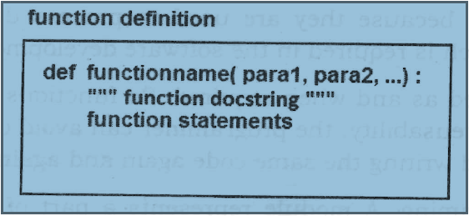
Consider the syntax of function, as shown below

Slide 8
Calling a Function
A function cannot run on its own.
It runs only when we call it.
So, the next step is to call the function using its name.
While calling the function, we should pass the necessary values to the function in the parentheses
Go to Jupyter notebook for examples

Slide 9
Returning results from a function
We can return the result or output from the function using a 'return' statement in the body of the function
If a function does not return any result, we need not write the return statement in the body of the function
Go to Jupyter notebook for examples

Slide 10
Returning multiple values form a function
A function returns a single value in the programming languages like C or Java.
But in python, a function can return multiple values.
When a function calculates multiple results and wants to return the results, we can use the return statement as:
return a, b, c
Here, three values which are in 'a', 'b', and 'c' are returned. These values are returned by the function as a tuple. Please remember a tuple is like a list that contains a group of elements. To grab these values, we can use three variables at the time of calling the function as:
x, y, z = function()
Here, the variables ‘x’, 'y' and 'z' are receiving the three values returned by the function.
Go to Jupyter notebook for examples

Slide 11
Functions are first class objects
In Python, functions are considered as first class objects.
It means we can use functions as perfect objects.
In fact when we create a function, the Python interpreter internally creates an object. Since functions are objects, we can pass a function to another function just like we pass an object (or value) to a function.
Also, it is possible to return a function from another function. This is similar to returning an object (or value) from a function.
The following possibilities are noteworthy:
It is possible to assign a function to a variable.
It is possible to define one function inside another function
It is possible to pass a function as parameter to another function.
It is possible that a function can return another function
Go to Jupyter notebook for examples

Slide 12
Pass by Object Reference
In the languages like C and Java, when we pass values to a function, we think about two ways:
Pass by value or call by value
Pass by reference or call by reference
Neither of these two concepts is applicable in Python.
In Python, the values are sent to functions by means of object references.
We know everything is considered as an object in python. All numbers are objects, strings are objects, and the datatypes like tuples, lists, and dictionaries are also objects.
Also, objects are created on heap memory. Heap memory is available during runtime of a program.
To know the location of an object in heap, we can use id() function that gives identity number of an object.

Slide 13
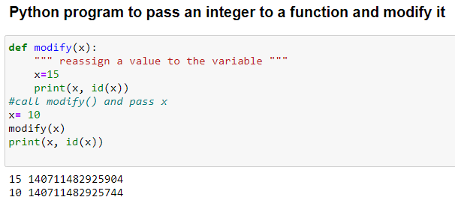
When we pass values like numbers, strings, tuples or lists to a function, the references of these objects are passed to the function
In python integers, floats, strings and tuples are immutable. That means their data cannot be modified. When we try to change their values, a new object is created with the modified value
Example

Slide 14
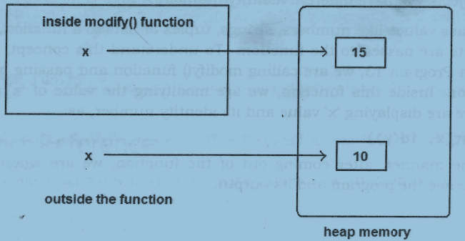

Slide 15
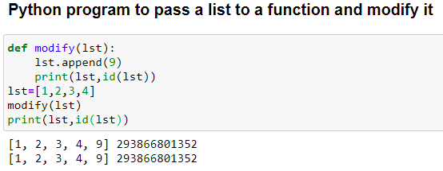
On the other hand, lists and dictionaries are mutable. That means, when we change their data, the same object get modified
Example

Slide 16
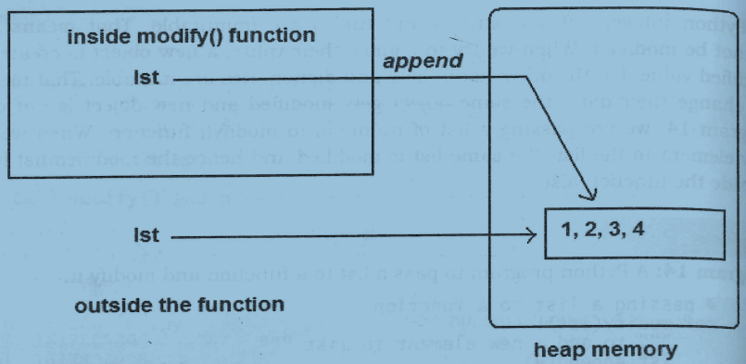

Slide 17
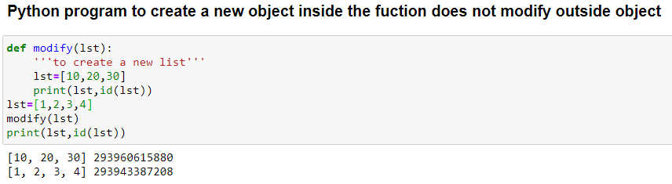
So, the final point is this: in Python, values are passed to functions by object references. If the object is immutable, the modified value is not available outside the function and if the object is mutable, its modified version is available outside the function.
A caution is needed here. If we create altogether a new object inside the function, then it will not be available outside the function.
Example

Slide 18
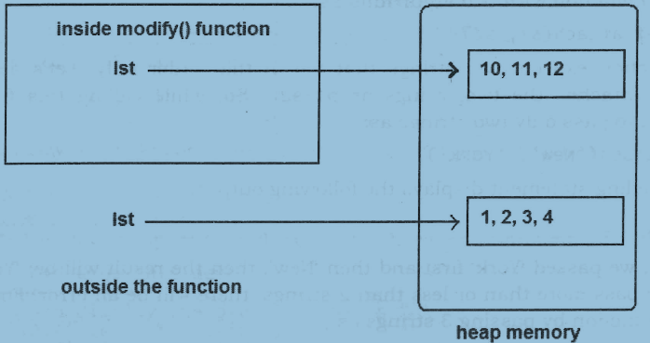

Slide 19
Formal and actual arguments
When a function is defined, it may have some parameters. These parameters are useful to receive values from outside of the function. They are called 'formal arguments'.
When we call the function, we should pass data or values to the function. These values are called `actual arguments'.
In the following code, 'a' and ‘b' are formal arguments and 'x' and 'y' are actual arguments.
def sum(a,b):
c=a+b
print(c)
x=10; y=15
sum(x,y)

Slide 20
The actual arguments used in a function call are of 4 types:
Positional arguments
Keyword arguments
Default arguments
Variable length arguments

Slide 21
Positional arguments
These are the arguments passed to a function in correct positional order. Here, the number of arguments and their positions in the function definition should match exactly with the number and position of the argument in the function call.
Keyword arguments
Keyword arguments are arguments that identify the parameters by their names.
Default arguments
We can mention some default value for the function parameters in the definition
Variable length arguments
Sometimes, the programmer does not know how many values a function may receive. In that case, the programmer cannot decide how many arguments to be given in the function definition.

Slide 22
Local and global variables
When we declare a variable inside a function, it becomes a local variable.
A local variable is a variable whose scope is limited only to that function where it is created.
That means the local variable value is available only in that function and not outside of that function.
When a variable is declared above a function, it becomes global variable. Such variables are available to all the functions which are written after it.
Go to Jupyter notebook for examples

Slide 23
The global keyword
The global variable and the local variable may have the same name.
In that case, the function, by default, refers to the local variable and ignores the global variable.
So, the global variable is not accessible inside the function but outside of it, it is accessible.
When the programmer wants to use the global variable inside a function, he can use the keyword 'global' before the variable in the beginning of the function body as:
global a

Slide 24
When the global variable name and local variable names are same, the programmer will face difficulty to differentiate between them inside a function
The globals() function will solve this problem.
This is a built in function which returns a table of current global variables in the form of a dictionary. Hence, using this function, we can refer to the global variable 'a', as: globals() ['a’]. Now, this value can be assigned to another variable, say ‘x’ and the programmer can work with that value.
Go to Jupyter notebook for examples

Slide 25

Passing a group of elements to a function
To pass a group of elements like numbers or strings, we can accept them into a list and then pass the list to the function where the required processing can be done
Go to Jupyter notebook for examples
Recursive function
A function that calls itself is known as 'recursive function'
Go to Jupyter notebook for examples

Slide 26
Anonymous functions or lambdas
A function without a name is called 'anonymous function'.
So far, the functions we wrote were defined using the keyword 'def’.
But anonymous functions are not defined using 'def’. They are defined using the keyword lambda and hence they are also called 'Lambda functions'.
Let's take a normal function that returns square of a given value.
def square(x):
return x*x
The same function can be written as anonymous function as: lambda x: x*x
Observe the keyword 'lambda'. This represents that an anonymous function is being created. After that, we have written an argument of the function, i.e. 'x'. Then colon ( : ) represents the beginning of the function that contains an expression x * x. Please observe that we did not use any name for the function here.
So, the format of lambda functions is:
lambda argument_list : expression
Go to Jupyter notebook for examples

Slide 27
Using Lambdas with filter() Function
The filter() function is useful to filter out the elements of a sequence depending on the result of a function. We should supply a function and a sequence to the filter() function as:
filter(function, sequence)
Here, the 'function' represents a function name that may return either True or False; and 'sequence' represents a list, string or tuple.
The 'function' is applied to every element of the 'sequence' and when the function returns True, the element is extracted otherwise it is ignored.
Go to Jupyter notebook for examples

Slide 28
Using Lambdas with map() Function
The map() function is similar to filter() function but it acts on each element of the sequence and perhaps changes the elements.
The format of map() function is:
map(function, sequence)
The 'function' performs a specified operation on all the elements of the sequence and the modified elements are returned which can be stored in another sequence.
Go to Jupyter notebook for examples

Slide 29
using Lambdas with reduce() Function
The reduce() function reduces a sequence of elements to a single value by processing the elements according to a function supplied.
The reduce() function is uses in the format:
reduce(function, sequence)
For example, we write the reduce() function with a lambda expression, as:
1st = [1, 2, 3, 4, 5] # take a list of numbers
reduce(lambda x, y: x*y, 1st)
Here, the reduce() function reduces the list to a final value as indicated by the lambda function.
The lambda function is taking two arguments and returning their product.
Hence, starting from the 0th element of the list '1st', the first two elements are multiplied and the product is obtained. Then this product is multiplied with the third element and the product is obtained. Again this product is multiplied with the fourth element and so on.

Slide 30
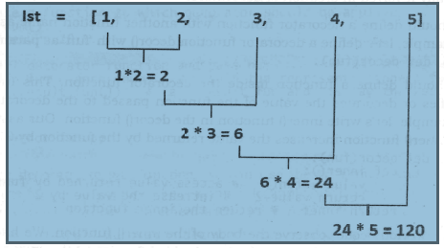
Since reduce() function belongs to functools module in Python, we are importing all from that module
Go to Jupyter notebook for examples

Slide 31
Function decorators
A decorator is a function that accepts a function as parameter and returns a function.
A decorator takes the result of a function, modifies the result and returns it.
Thus decorators are useful to perform some additional processing required by a function.
Decorators concept is a bit confusing but not difficult to understand
The following steps are generally involved in creation of decorators:
We should define a decorator function with another function name as parameter.
We should define a function inside the decorator function. This function actually modifies or decorates the value of the function passed to the decorator function
Return the inner function that has processed or decorated the value.

Slide 32
To apply the decorator to any function, we can use the ‘@’ symbol and decorator name just above the function definition
Go to Jupyter notebook for examples

Slide 33
Generators
Generators are functions that return a sequence of values.
A generator function is written like an ordinary function but it uses ‘yield’ statement. This statement is useful to return the values
Once the generator object is created, we can store the elements of the generator into a list and use the list as we want.
Go to Jupyter notebook for examples

Slide 34
Structured programming
The purpose of programming is to solve problems related to various areas. Starting from simple problems like adding two numbers to very complex problems like designing the engine of an aircraft, any problem can be solved through programming. When there is a simple problem, the programmer can solve it by writing a simple program. But When there is a complex problem, he may have to develop a lengthy code.
Solving a complex problem is a challenging task for the programmer. For this purpose, structured programming is the strategy used by programmers in general. In structured programming, the main task is divided into several parts called sub tasks and each of these sub tasks is represented by one or more functions. By using these functions, the programmer can accomplish the main task.
Go to Jupyter notebook for examples

Slide 35
Creating our own modules in python
A module represents a group of classes, methods, functions and variables.
While we are developing software, there may be several classes, methods and functions. We should first group them depending on their relationship into various modules and later use these modules in the other programs. It means, when a module is developed, it can be in any program that needs that module.
In Python, we have several built-in modules like sys, io, time etc.
Just like these modules, we can also create our own modules and use them whenever we need them.
Once a module is created, any programmer in the project team can use that module. Hence, modules will make software development easy and faster.
Go to IDLE for examples

Slide 36
The special variable __name__
When a program is executed in Python, there is a special variable internally created by the name ' __name__ '.
This variable stores information regarding whether the program is executed as an individual program or as a module.
When the program is executed directly, the Python interpreter stores the value ‘__main__' into this variable.
When the program is imported as a module into another program, then Python interpreter stores the module name into this variable.
Thus, by observing the value of the variable ‘__name__', we can understand how the program is executed.
Go to IDLE for examples

